Slide 1
Composite Pattern
By
Narendran, S S

Slide 2
Key Items
Similar to Decorator.
IS A and HAS A Relationship
Recursive Wrapping of collection
Has “Indirection by Default” behavior.
Power of Extension at runtime with Composition
“Favor Composition over Inheritance” & “Open for Extension, Closed for Modification”
Class Explosion with Inheritance. Inheritance is static to add behavior.
Partial “Is a” Relationship Achieved with “Has a” Relationship by Constructor Injection – Extend at Runtime instead of Compile time.
Overriding by Contract and access of properties & public methods by Object Inspection.
Effective Change Management, yet Changes are always prone to error.

Slide 3
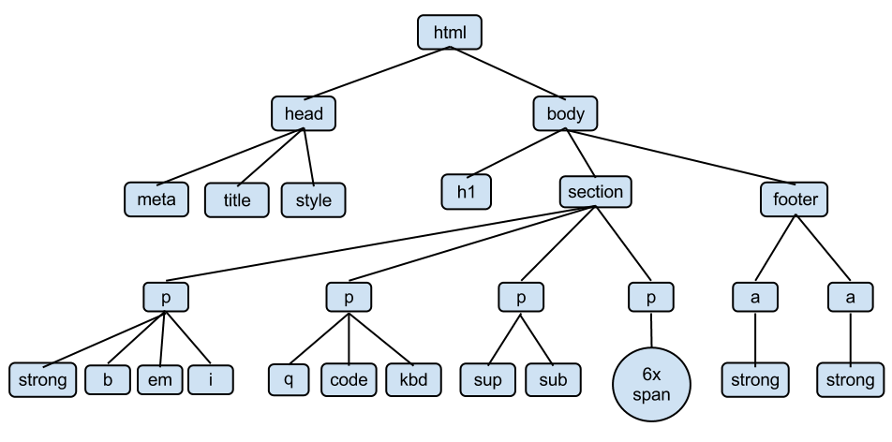
Composite Pattern
The composite pattern describes that a group of objects are to be treated in the same way as a single instance of an object. The intent of a composite is to "compose" objects into tree structures to represent part-whole hierarchies. Implementing the composite pattern lets clients treat individual objects and compositions uniformly.

Slide 4
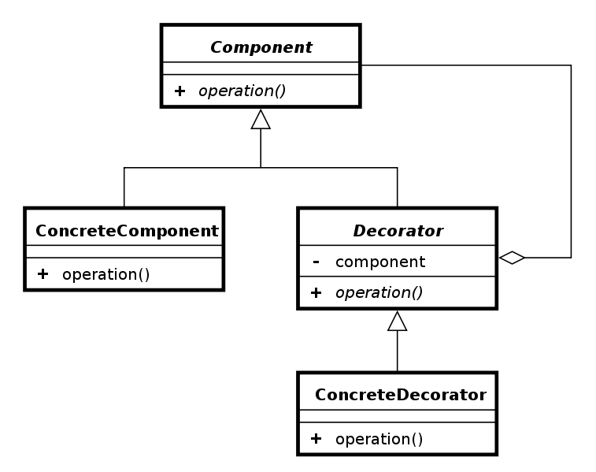
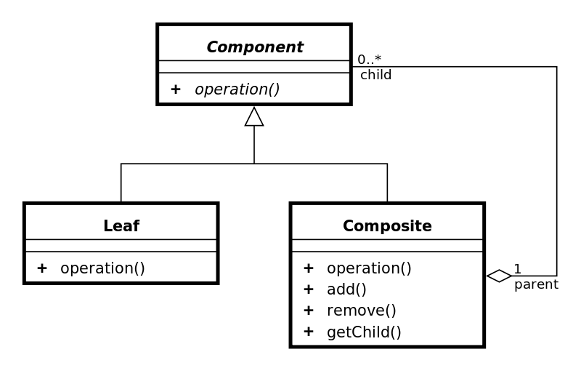
Composite Pattern - UML

Slide 5
Pros and Cons
Pros
Helpful Especially for Tree Structures – Data / Components
Lot no. of Class Creation can be avoided.
Can work along with Decorator Pattern.
Will help to establish Hierarchical structures
Cons
Instead of Class Explosion, Object Explosion can happen.
Indirection is introduced – All the leafs need to be created before creating the Composite component.

Slide 6
References
http://javapapers.com/design-patterns/composite-design-pattern/
http://www.tutorialspoint.com/design_pattern/composite_pattern.htm
http://sourcemaking.com/design_patterns/composite
http://www.oodesign.com/composite-pattern.html

